Slide 1
Northeastern University
Alzheimers MRI Image classification using CNN
Yue Lyu, Siyu Fang, Shradha Kaushal, Lu Yin, Aditya Pawar
MATH 7243 Machine Learning

Slide 2
CONTENTS
BACKGROUND
DATA PREPROCESSING
2D CNN
3D CNN
CORRELATION
CONCLUSION
LIMITATION
PART ONE
PART TWO
PART THREE
PART FOUR
PART FIVE
PART SIX
PART SEVEN

Slide 3
Northeastern University
BACKGROUND
PART ONE

Slide 4
PART ONE
Alzheimer’s disease is a type of progressive dementia that causes irreversible brain cell degeneration.
At present, there are around 90 million people suffer with AD, and it is estimated that the number of AD patients will reach 300 million by 2050.
Currently, there is no effective cure therefore, early detection is key.
The most commonly used neuroimaging technology to detect Alzheimer’s is a (FDG) PET scan, which can identify brain regions with decreased glucose metabolism.

Slide 5
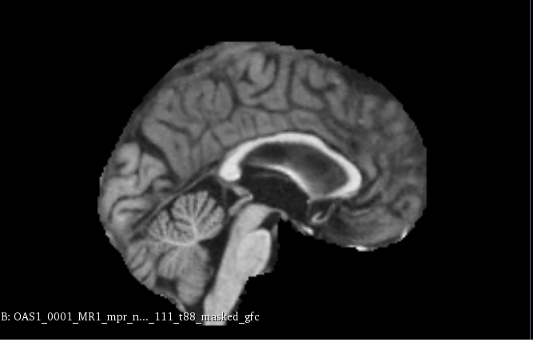
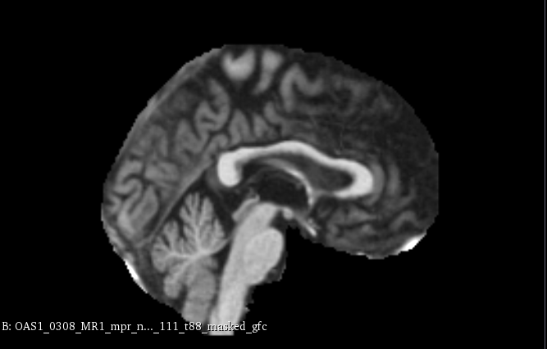
PART ONE
Normal Human Brain Alzheimer’s Patient’s Brain

Slide 6
Northeastern University
DATA PREPROCESSING
PART TWO

Slide 7
PART TWO
Firstly, we used all 436 images to do the test, and we got around over 94% accuracy. But after printing the test data, we noticed that all the data were labeled as non-AD patient. So we got FALSE HIGH ACCURACY.
Almost 77% of the data being of non-AD patients and only 23% of patients have Alzheimer. So, when we learn such data we are learning more images of the people without AD, which will affect our testing accuracy although we get a good training accuracy.

Slide 8

PART TWO
Do Undersampling
Change the label “0.5”, “1.0”, “2.0” into “1” as the patient having AD.
Choose 100 people from the non-AD patients and AD patients respectively to do the test.
We did the undersampling instances of majority class (people without AD).

Slide 9
PART TWO
We also could have done oversampling but it comes with flaws:
The increased computational power
Oversampling the minority class can lead to model overfitting since it will introduce duplicate instances, drawing from a pool of instances that is already small.

Slide 10
PART TWO
Preprocess the data and provide labels to each of the images.
Use one hot encoder for machine to understand the labels.
Note: the image size is 176x208x176. We reshape it to 150x150 in 2D images and 88x104x88 in 3D images.

Slide 11
Northeastern University
2D CNN
PART THREE

Slide 12
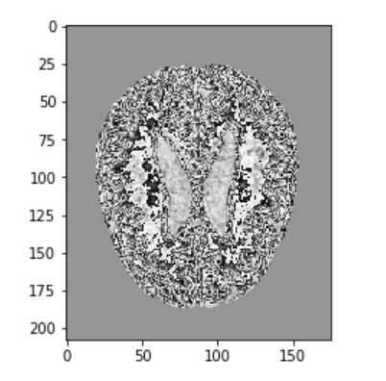
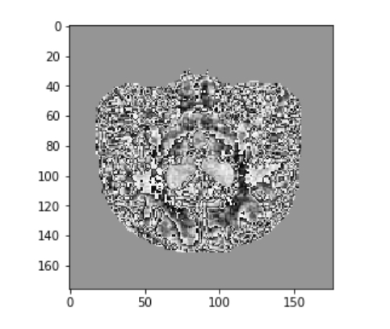
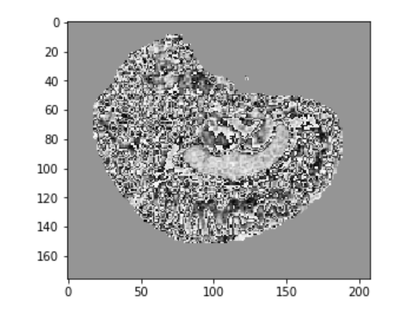
PART THREE
The way we change 3D images into 2D images is cutting one axis, and because we do not know which axis we cut can get the best result, so we do all the three axis.
Cut on x axis
Cut on y axis
Cut on z axis

Slide 13
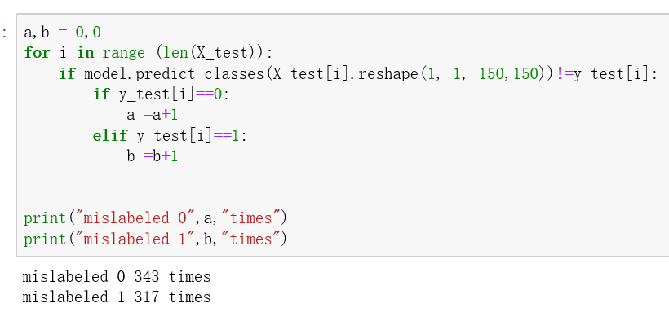
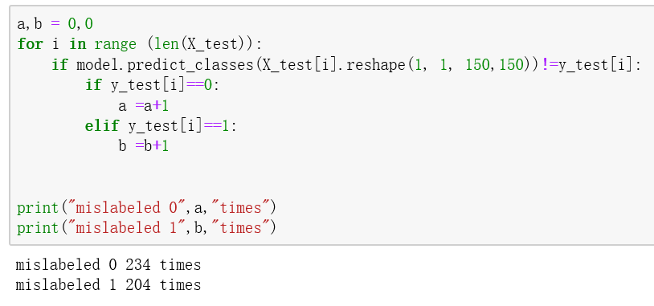
PART THREE
A) Augmentation
To make a better test data, we augmented the data set by ﬂipping each image thus giving us twice as many images as the original test data.
We tried two ways:
We flipped over the images first and then separated train and test data
We separated train and test data first and flipped over the images later.
To prevent the test data has too much “0” or “1” , which may cause the false high accuracy, to prevent this situation, we print the number of mislabeled “0” and “1”. We can find that they keep a good balance.

Slide 14
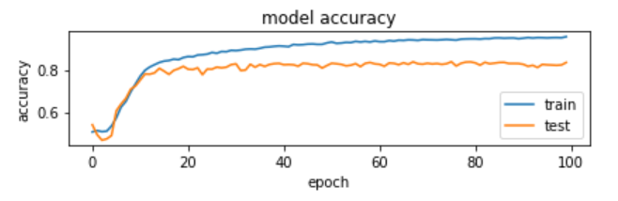
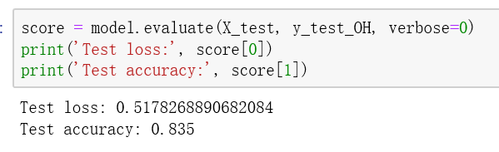
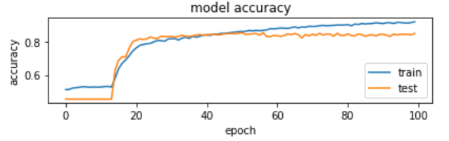
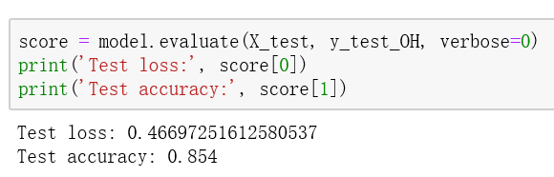
PART THREE
We chose the 40-80 group on x axis as the example:
The accuracy of first way: 0.835
The accuracy of second way: 0.854
We can find there is no big difference between the accuracy of two ways.

Slide 15
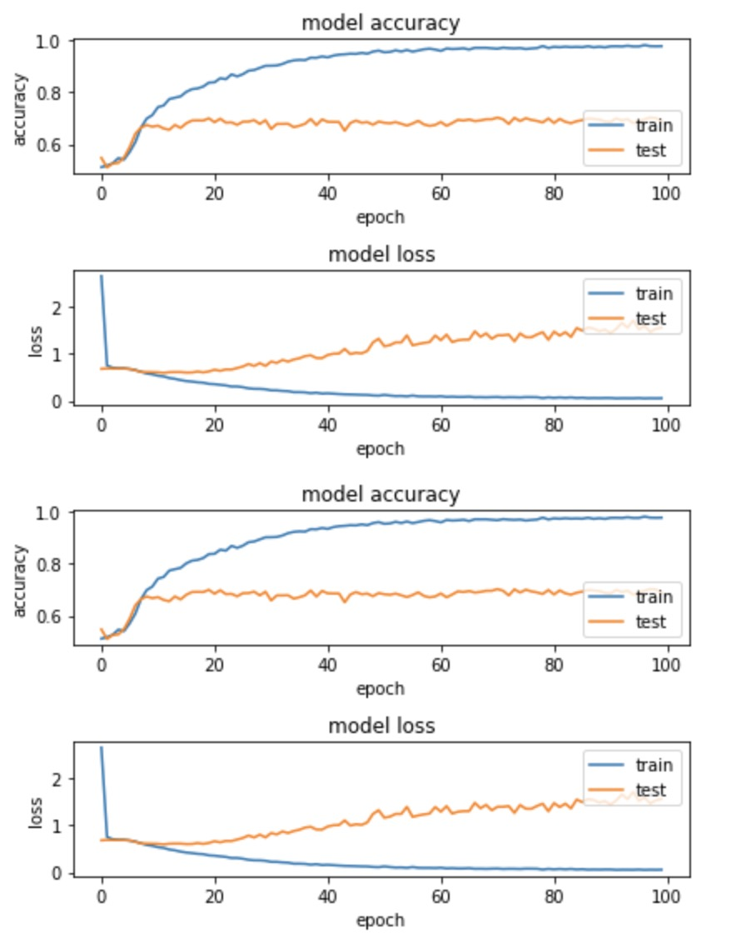
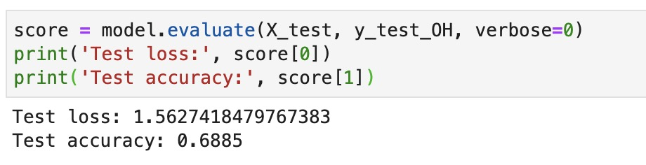
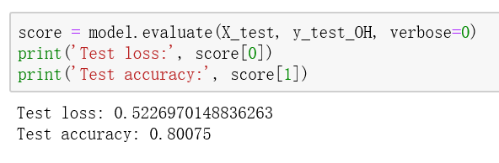
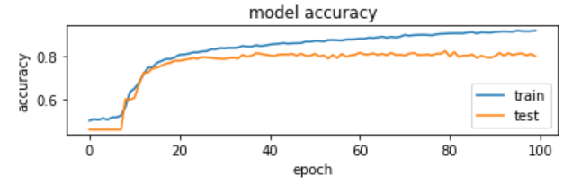
PART THREE
We chose the 80-120 group cut on z axis as the example
The accuracy before augmentation: 0.6885
The accuracy after augmentation: 0.80075
We can see from the above, the accuracy has obvious improvement after augmentation.

Slide 16
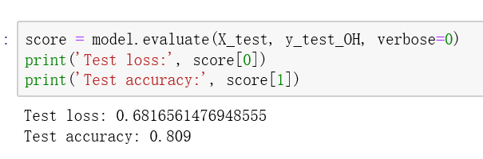
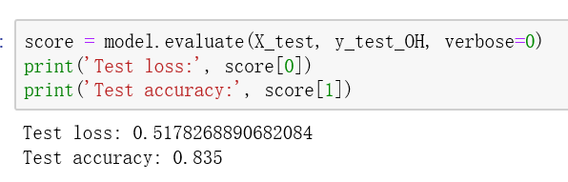
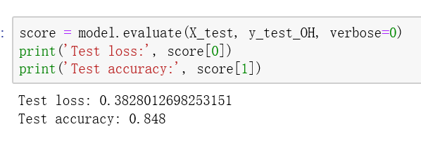
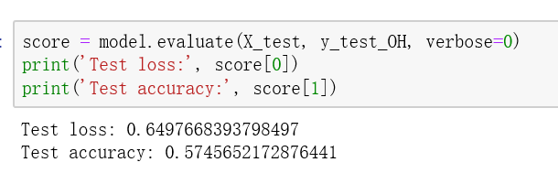
B) Comparison among different slices from one axis and Comparison among x, y and z axis
We chose almost 40 slices into a group.
1) Comparison among different slices from one axis
a) The accuracy of all the groups on x axis.
0-40 group: 0.809
40-80 group: 0.835
80-120 group: 0.848
120-176 group: 0.575
We can find the 40-80 and 80-120 groups have better accuracy.
PART THREE

Slide 17
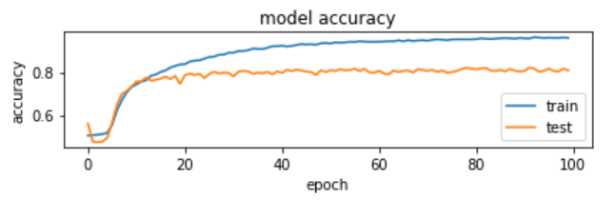
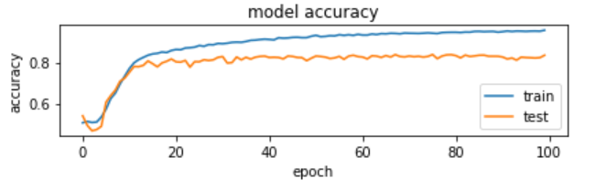
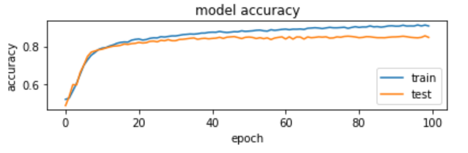
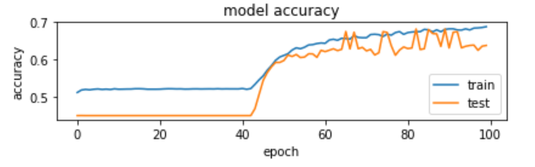
PART THREE
0-40 group: 0.809
40-80 group: 0.835
80-120 group: 0.848
120-176 group: 0.575

Slide 18
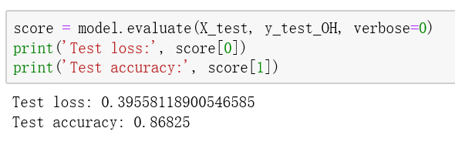
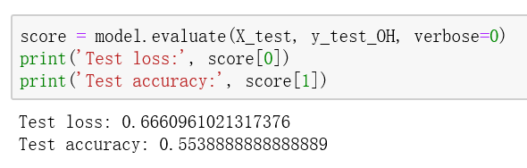
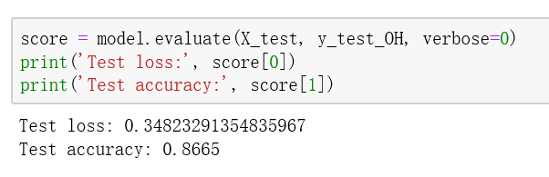
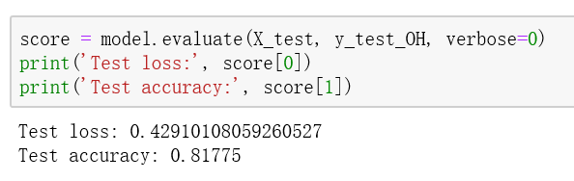
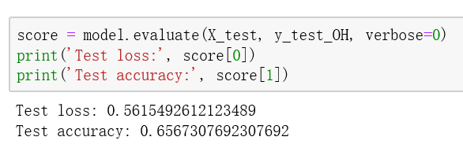
B) Comparison among different slices from one axis and Comparison among x, y and z axis
1) Comparison among different slices from one axis
80-120 group: 0.868
b) The accuracy of all the groups on y axis.
0-40 group: 0.554
120-160 group: 0.8665
40-80 group: 0.818
160-208 group: 0.6567
We can find 80-120 and 120-160 groups have better accuracy.
PART THREE

Slide 19
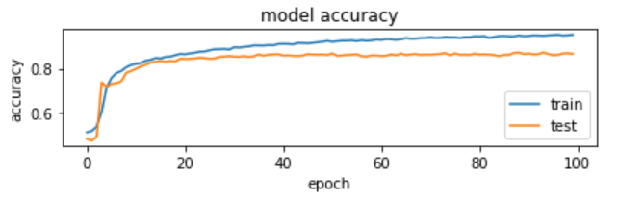
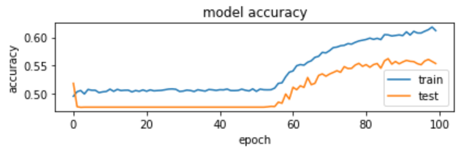
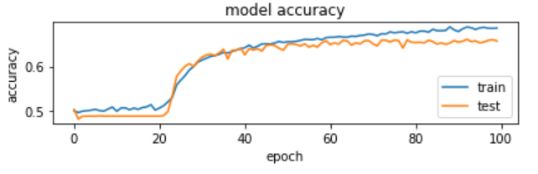
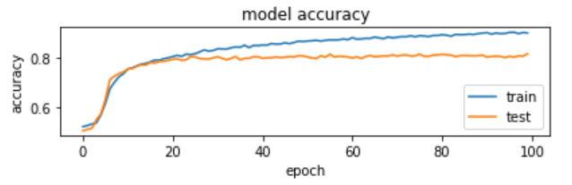
PART THREE
80-120 group: 0.868
0-40 group: 0.554
120-160 group: 0.8665
40-80 group: 0.818
160-208 group: 0.6567

Slide 20
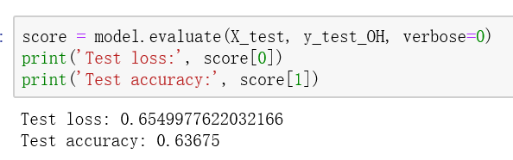
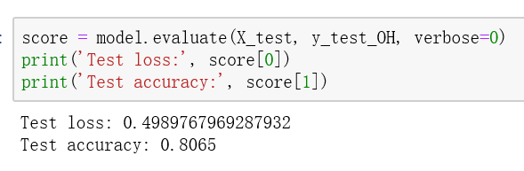
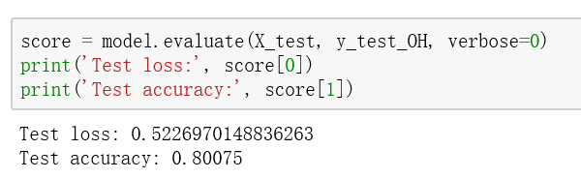
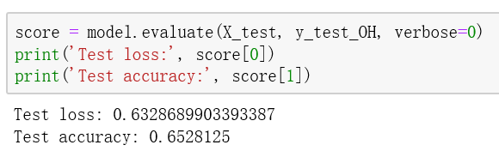
B) Comparison among different slices from one axis and Comparison among x, y and z axis
1) Comparison among different slices from one axis
c) The accuracy of all the groups on z axis.
0-40 group: 0.637
40-80 group: 0.8065
80-120 group: 0.801
120-176 group: 0.653
We can find the 40-80 and 80-120 groups have better accuracy.
PART THREE

Slide 21
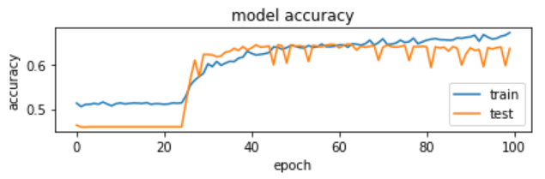
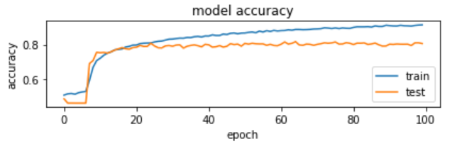

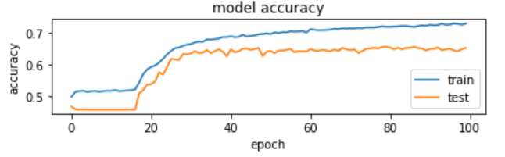
PART THREE
0-40 group: 0.637
40-80 group: 0.8065
80-120 group: 0.801
120-176 group: 0.653

Slide 22
B) Comparison among different slices from one axis and Comparison among x, y and z axis
2) Comparison among x, y and z axis
The highest accuracy of the group on x axis is 0.848
The highest accuracy of the group on y axis is 0.868
We can see that the accuracy getting from three axis looks similar, but choosing x and y axis slightly better than z axis.
The highest accuracy of the group on z axis is 0.8065
PART THREE

Slide 23
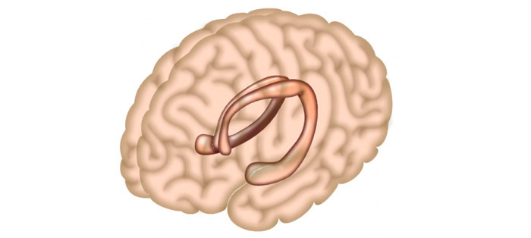
PART THREE
Hippocampus: responsible for the memory and in Alzheimer’s disease, the hippocampus is the first area to be affected.
We can see from the previous conclusions that almost on the all three axis, the groups in the middle have better accuracy. Comparing with the picture of brain on the Internet, we can find this part is near the position of hippocampus. So, our results are reasonable.

Slide 24
Northeastern University
3D CNN
PART FOUR

Slide 25
PART FOUR
A) Data Augmentation
1) Rotation:
Augmentation can be done in many ways, we
chose rotation on 3D data for these reasons:
a) We tried flipping 2D image slices, although it takes a lot
of time to flip the array, therefore it is not practical to
implement the same methodology on the 3D data
b) Whereas, rotation keeps the 3D image intact unlike scale or crop etc. and if every image in the data set is rotated then each new image will be considered as a new data point
for the neural network to train on

Slide 26
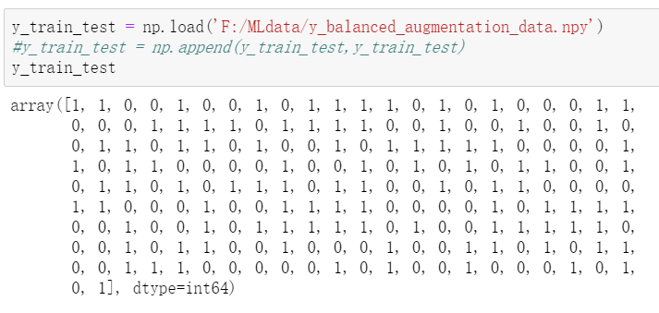
PART FOUR
A) Data Augmentation
2) Preprocess data :

Slide 27
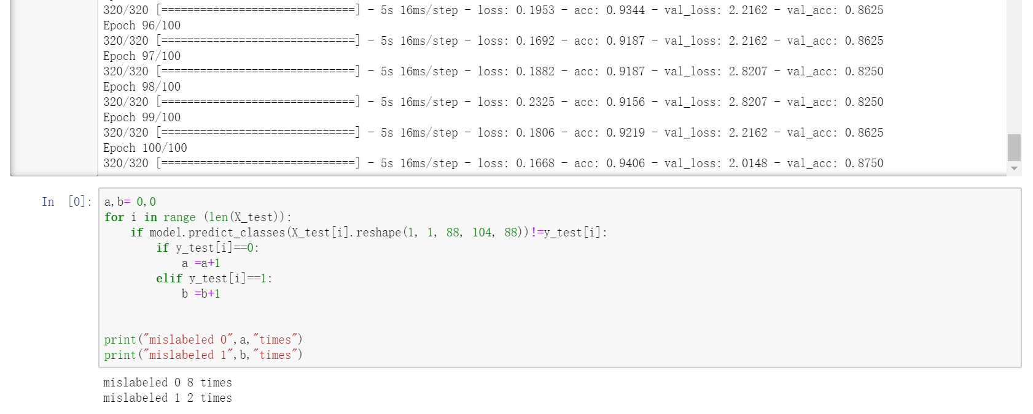
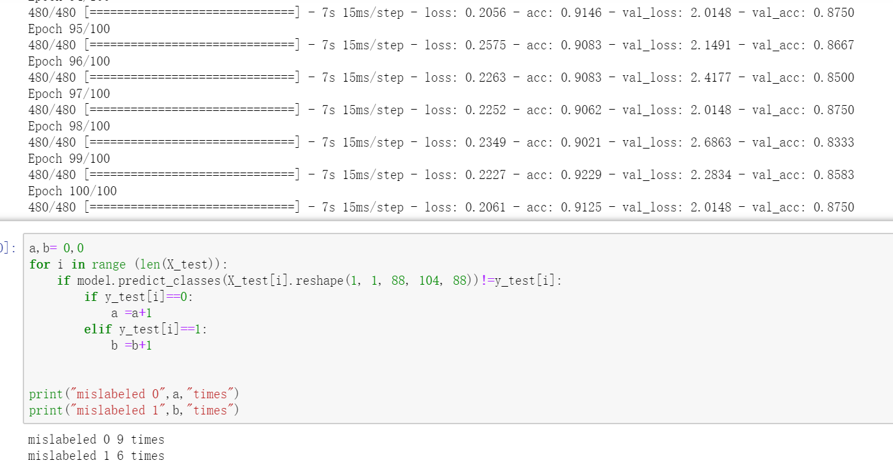
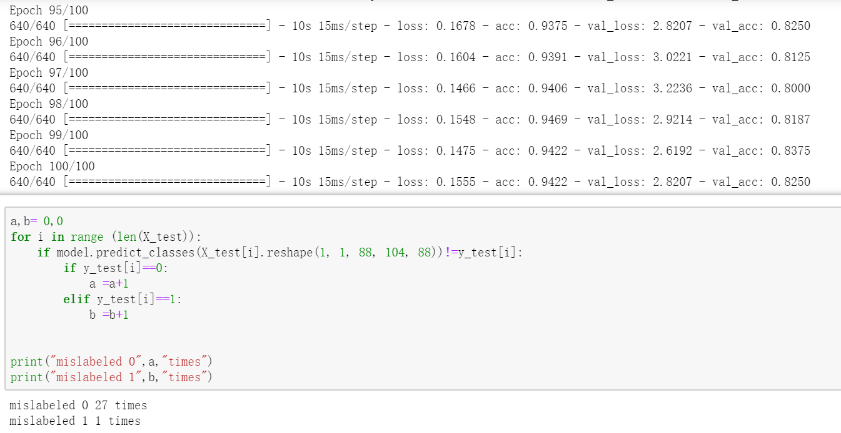
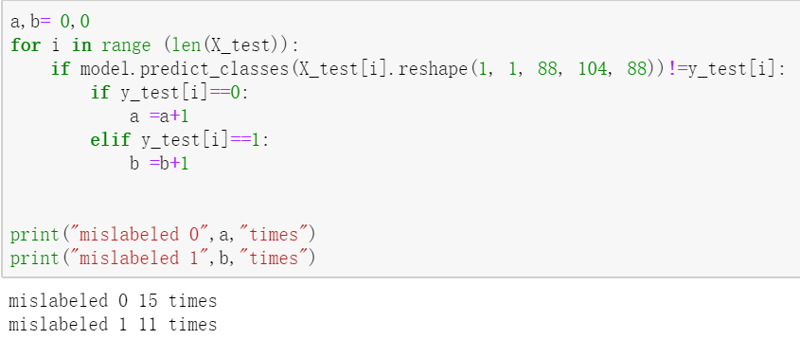
3) Application
PART FOUR
Closewise +10 acc : 87.5%
Clockwise +20 acc : 87.5%
Anti-clockwise -10 acc : 82.5%
Anti-clockwise acc : 87%

Slide 28
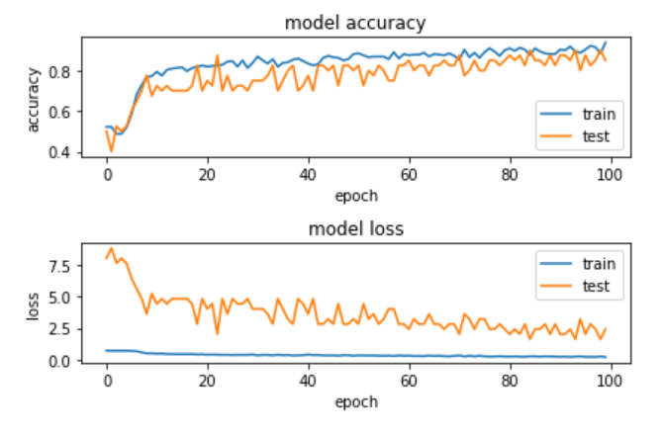
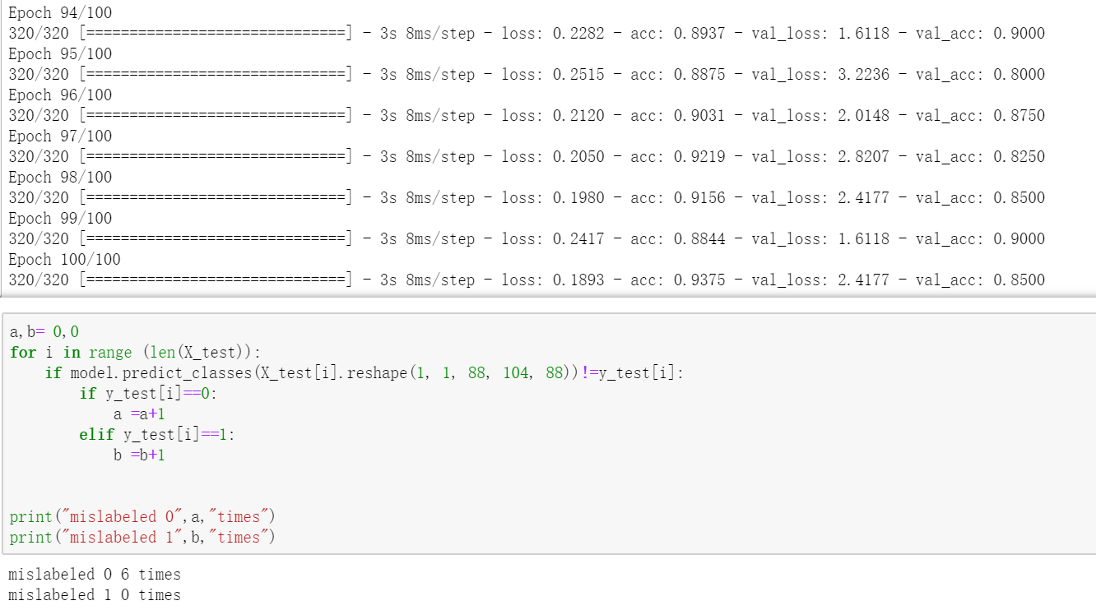
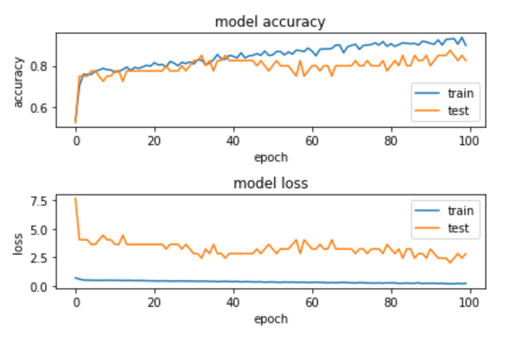
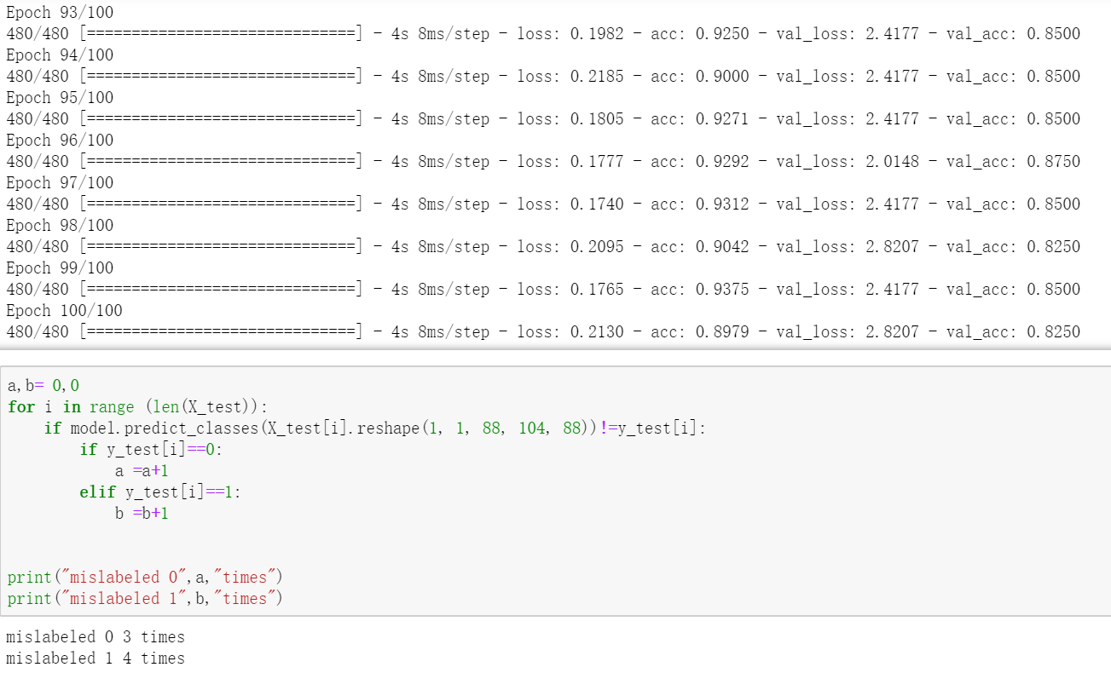
3) Application
PART FOUR
There we rotated test data together with train set, it just
increased the data size but splitting test data before rotating is scientiftic
:
Clockwise +10 accuracy : 85%
Anti-clockwise accuracy : 83%

Slide 29
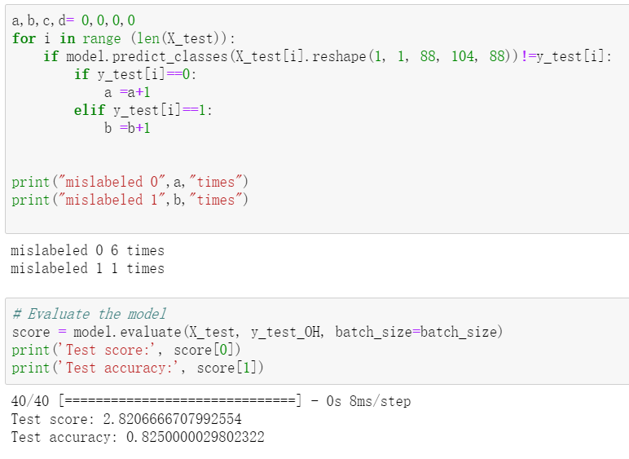
4) Conclusion
PART FOUR
Before Rotation
Rotation without test data is more scientific and logical, also do augmentation is useful for the
accuracy is little higher than without rotation the whole data (82.5%), and accuracy is a little going down between every rotation step due to the data set size grows, but the prediction doesn’t have any tendency.
However, since we separated the train and test dataset before doing augmentation, another
problem arises, we only have 40 test data, and whether it is a small but representative test data set is hard to prove.

Slide 30

B) Whether to Normalize Test Data
Normalization considered as an important application because machine is incredibly difficult to stores objects in a relational database that maintains the same information in several places.
The goal of data normalization is to reduce and even eliminate data redundancy.
We used two ways to compare, one is scaling all the data and then splitted into train/test data sets, the other is only normalizing training data set and leaving the test set.
PART FOUR

Slide 31


B) Comparison with Normalize both train and test data set after splitting and rotation
PART FOUR
Normalize Test data
Not Normalize Test data
Clockwise +10 Acc : 72.5%
Clockwise +10 Acc : 85%
Anti-clockwise -10 Acc : 77.5%
Anti-clockwise -10 Acc : 83%

Slide 32

Analysis
PART FOUR
Normalize Test data
Not Normalize Test data
It turns out accuracy of only normalizing training data is higher than the normalizing the whole data.
We have an assumption that the unnormalized test using training parameters can do well in MSE scores because sampling errors may negatively bias the predictions. And if we are not trying to produce a generalized predictive model but are instead trying to understand the underlying mathematical structure of the given data set then splitting the data after normalization is reasonably safe.

Slide 33




C) Improvements
PART FOUR
1) Enlarge zip scale
Acc on half scale
Acc on 0.75 scale
We can see that the accuracy
Accuracy 88x104x88 Accuracy132x156x132

Slide 34

C) Improvements
PART FOUR
2) Model Architecture

Slide 35


C) Improvements
PART FOUR
VGG-like convnet from keras.optimizers import SGD
2) Model Optimizer

Slide 36


C) Improvements
PART FOUR
Adding SGD
Before add SGD

Slide 37



C) Improvements
PART FOUR
Less parameters
More parameters

Slide 38
PART FOUR
D. Grid Search
Hyperparameter optimization is a big part of deep learning. The reason is that neural networks are notoriously difficult to configure and there are a lot of parameters that need to be set right to get the best accuracy with less loss. On top of that, individual models worked very slow to train especially the 3D CNN which consists of a huge matrix.
Grid search provides broad range of options for every hyper parameter and iterate those through the best and throws out the best fitting option according to the highest accuracy. This helps us to make the architecture more efficient.

Slide 39
PART FOUR
Following are the hyperparameters we tried to tune:
1) Batch size and Number of Epochs
2) Learning rate and momentum
3) Optimization algorithm
4) Activation Function
5) Weights

Slide 40
PART FOUR
Best results for the above hyperparameters on our dataset we got after grid search are:
1) Batch size = 2, Number of Epochs = 100
2) Learning rate = 0.2
3) Optimization algorithm = ’Adam’
4) Activation Function = ’softmax’
5) Weights = ’normal’

Slide 41
Northeastern University
CORRELATION
PART FIVE

Slide 42

PART FIVE
Pair plot for Age, Delay, Educ, SES, MMSE, CDR, eTIV, nWBV and ASF.

Slide 43
PART FIVE
Heat Map
eTIV and ASF, nWBV and Age are negative correlation.

Slide 44




Classifier Score for Logistic Regression, DecisionTreeClassifier, KNeighborsClassifier, and SVC
train: 0.57
test: 0.56
train: 0.655
test: 0.625
train: 0.664
test: 0.580
train: 0.57
test: 0.568
PART FIVE

Slide 45
Classifier scores for DecisionTreeClassifier and KNeighborsClassifier are higher than the Logistic Regression and SVC.
Neural Net Tensorflow
DecisionTreeClassifier
KNeighborsClassifier
PART FIVE
We cannot say which method is better since their accuracy are similar and both of them are not too high.

Slide 46
Northeastern University
CONCLUSION
PART SIX

Slide 47
PART SIX
We were able to build the 2D CNN model and the 3D CNN model with the best possible accuracy.
2D approach has lower computational and memory requirements, compared to one using 3D images
However, an important drawback of such an approach is that 3 axis anatomic correlation is completed discarded.

Slide 48
Northeastern University
LIMITATION
PART SEVEN

Slide 49
PART SEVEN
The dataset is small and biased with only 100 patients diagnosed with AD out of a total of 436. Therefore, overfitting is still a critical challenge in training a deeper CNN model with a limited number of training samples compared to the large number of learnable parameters (Shen et al., 2017). One way to solve this would be to get more data with equal distribution of AD and non-AD patients.

Slide 50
PART SEVEN
The dataset is small and biased with only 100 patients diagnosed with AD out of a total of 436. Therefore, overfitting is still a critical challenge in training a deeper CNN model with a limited number of training samples compared to the large number of learnable parameters (Shen et al., 2017). One way to solve this would be to get more data with equal distribution of AD and non-AD patients.
Since the data we are working with is very heavy, each image being of size 176x208x176 voxels and 436 of such images, it takes a long time for epochs to run on CPU. To successfully understand and train better models, we need to run more epochs on a computer with better processing speed or a GPU.

Slide 51
PART SEVEN
The dataset is small and biased with only 100 patients diagnosed with AD out of a total of 436. Therefore, overfitting is still a critical challenge in training a deeper CNN model with a limited number of training samples compared to the large number of learnable parameters (Shen et al., 2017). One way to solve this would be to get more data with equal distribution of AD and non-AD patients.
In 2D approach, we slices 40 images in each head and append label continuously, in other words, we didn’t shuffle the train data before test accuracy, thus it can influence result.
Since the data we are working with is very heavy, each image being of size 176x208x176 voxels and 436 of such images, it takes a long time for epochs to run on CPU. To successfully understand and train better models, we need to run more epochs on a computer with better processing speed or a GPU.

Slide 52
THANK YOU FOR WATCHING

